Slide 1
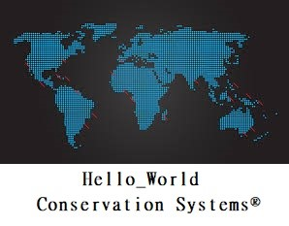
ONLINE
LOGIN ID
PASSWORD
SAVE USERNAME
TOKEN AUTH
LOG IN
Version 1.2

Slide 2
ONLINE
Sea_Turtle_Saviors
***************
SAVE USERNAME
S3R4B45M
LOG IN
Version 1.2

Slide 3

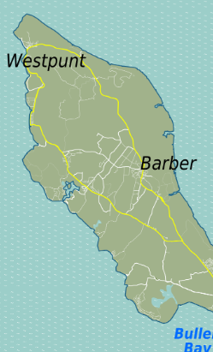
ONLINE
Sea_Turtle_Saviors
LOCAL TIME: 14:32
SEPT. 26, 2018
SIGNAL
HELP
Latitude Longitude
12.169570° N 68.990021° W
LOGOUT
SEARCH AREA
SEARCH FILTER
CURRENT FILTERS
UPLOAD NEST INFORMATION
ORGANIZATION CONTACTS
SETTINGS
ABOUT/VERSION
CHANGE MAP TYPE

Slide 4

ONLINE
Sea_Turtle_Saviors
LOCAL TIME: 14:33
SEPT. 26, 2018
SIGNAL
HELP
Latitude Longitude
12.169570° N 68.990021° W
LOGOUT
NEW NEST INFORMATION
SPECIES
NEST AGE
NEST INFORMATION
TAKE PHOTO
UPLOAD NEST INFORMATION TO DATABASE
LOCAL HAZARDS
ORGANIZATION INFORMATION
BACK

Slide 5
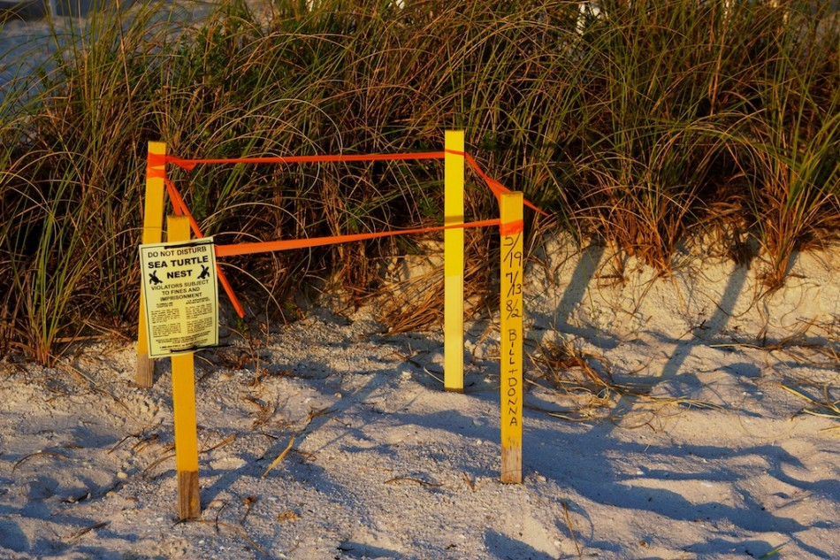
ONLINE
Sea_Turtle_Saviors
LOCAL TIME: 14:34
SEPT. 26, 2018
SIGNAL
HELP
Latitude Longitude
12.169570° N 68.990021° W
LOGOUT
NEW NEST INFORMATION
SPECIES
NEST AGE
NEST INFORMATION
TAKE PHOTO
UPLOAD NEST INFORMATION TO DATABASE
LOCAL HAZARDS
ORGANIZATION INFORMATION
BACK

Slide 6
ONLINE
Sea_Turtle_Saviors
LOCAL TIME: 14:35
SEPT. 26, 2018
SIGNAL
HELP
Latitude Longitude
12.169570° N 68.990021° W
LOGOUT
NEW NEST INFORMATION
SPECIES
Hawksbill
NEST AGE (Approximate)
2 Weeks
NEST INFORMATION
TAKE PHOTO
Near pathway, approx. 20 feet left of exit near “leaving Kokomo beach” sign.
Appears to be healthy and untouched.
Local wildlife authorities will be monitoring.
UPLOAD NEST INFORMATION TO DATABASE
LOCAL HAZARDS
Popular swimming/snorkeling beach with a lot of human foot traffic.
UPLOAD SUCCESSFUL!
ORGANIZATION INFORMATION
Sea_Turtle_Saviors
123 Smith Lane
Willemstad, Curacao
011 599 9 02234
STS@gmail.com
BACK

Slide 7
ONLINE
Sea_Turtle_Saviors
LOCAL TIME: 14:36
SEPT. 26, 2018
SIGNAL
HELP
Latitude Longitude
12.169570° N 68.990021° W
LOGOUT
SEARCH AREA
SEARCH FILTER
CURRENT FILTERS
UPLOAD NEST INFORMATION
ORGANIZATION CONTACTS
SETTINGS
ABOUT/VERSION
CHANGE MAP TYPE

Slide 8
ONLINE
Sea_Turtle_Saviors
LOCAL TIME: 14:37
SEPT. 26, 2018
SIGNAL
HELP
Latitude Longitude
12.169570° N 68.990021° W
LOGOUT
SEARCH AREA
SEARCH FILTER
CURRENT FILTERS
Loggerhead Nest
Lat 12.183043
Long 68.321456
EST Hatch: DEC 2, 2018
ACTIVE
UPLOAD NEST INFORMATION
GPS
SHOWMORE
ORGANIZATION CONTACTS
SETTINGS
ABOUT/VERSION
CHANGE MAP TYPE

Slide 9
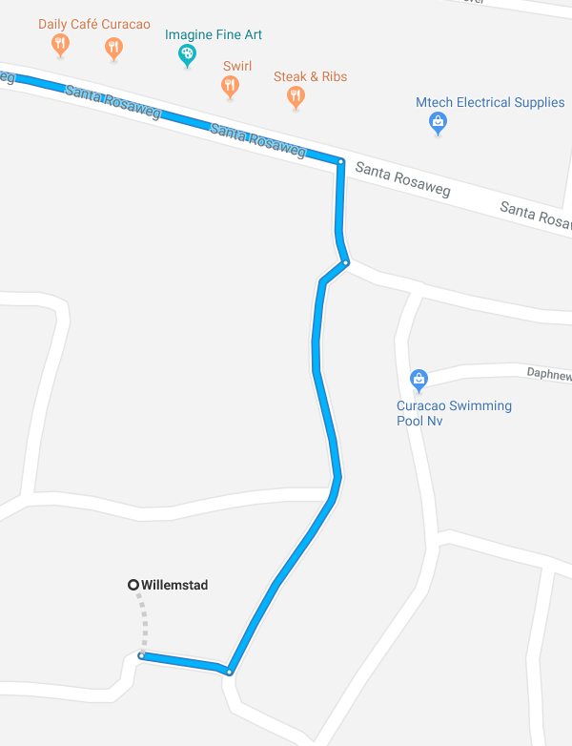
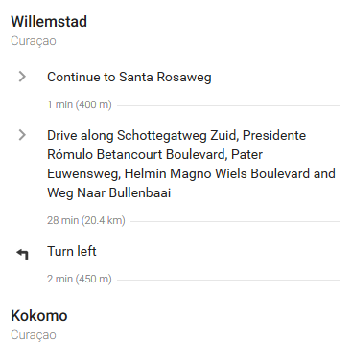
ONLINE
Sea_Turtle_Saviors
LOCAL TIME: 14:39
SEPT. 26, 2018
SIGNAL
HELP
Latitude Longitude
12.169570° N 68.990021° W
LOGOUT
WALKING/DRIVING
WALKING/
DRIVING
FULL SCREEN
BACK
SETTINGS
ABOUT/VERSION

Slide 10
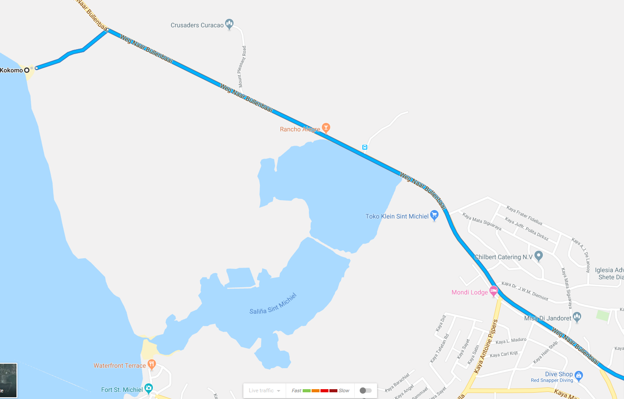
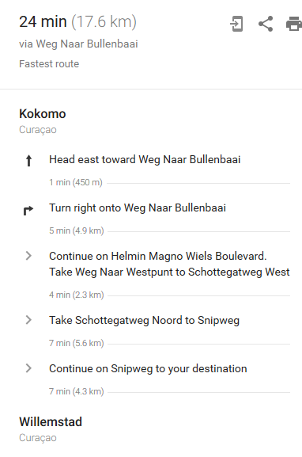
BACK

Slide 11
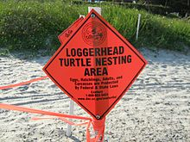
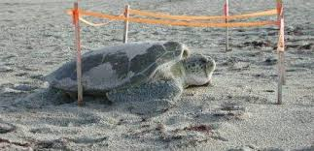
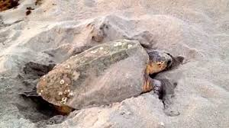
ONLINE
Sea_Turtle_Saviors
LOCAL TIME: 14:41
SEPT. 26, 2018
SIGNAL
HELP
Latitude Longitude
12.169570° N 68.990021° W
LOGOUT
Loggerhead nest #231
Lat 12.183043
Long 68.321456
Est hatch date: Dec 2, 2230
SPECIES
Loggerhead
NEST AGE
7 weeks, 3 days
NEST INFORMATION
Secluded beach, no possible human interactions. Requires 30 minute hike through low brush. Nest seems healthy but local bird populations may attempt to take unhatched eggs.
LOCAL HAZARDS
Local wildlife may interfere with the nest.
ORGANIZATION INFORMATION
Curacao sea turtle conservation
332 Bright St.
Willemstad, Curacao
11 550 233495
CSTC@gmail.com
BACK

